Slide 1


NAHEEM FARRI
JUNE 28TH, 2024

Slide 2

Outline
Executive Summary
Introduction
Methodology
Results
Conclusion
Appendix

Slide 3
Executive Summary
Data collection methodology:
Requested data from the API
Cleaned by filtering and removing the null values
Perform data wrangling
Scraped launch data using "BeautifulSoup"
Created a dataframe
Perform exploratory data analysis (EDA) using visualization and SQL
Explored data using magic sql - "WHERE" clause, "GROUP BY" function, etc

Slide 4
Executive Summary
Perform interactive visual analytics using Folium and Plotly Dash
Plotted landing points on a map with folium
Created a dashboard with Plotly Dash
Perform predictive analysis using classification models
Trained and tested data
Fit them with classification models
Found the accuracy of predictions

Slide 5
Introduction
SpaceX advertises Falcon 9 rocket launches on its website, with a cost of 62 million dollars; other providers cost upward of 165 million dollars each, much of the savings is because SpaceX can reuse the first stage.
In this case we are a company "SpaceY" that is hoping to bid successfully against SpaceX
We are tasked to determine if the first stage will land which will determine the cost of a launch.

Slide 6

Section 1

Slide 7
Methodology
We made use of the SpaceX API to get launch data for rocket launches
We proceeded to sort the data we wanted, cleaned the data and removed null values
These help us get the data we later use for analysis and visualizations
We can then get the most successful launch sites and use this as the site for our launches
This will reduce the cost of launching from sites that produce unsuccessful launches

Slide 8
Data Collection – SpaceX API
Main Process:
Request data from the launch API.
Sub Processes:
Request rocket data from launch API
Request launchpad data from launch API
Request payload data from launch API
Request rocket data from launch API
URL:
https://github.com/NAHEEM765/ADS_Capstone/blob/main/01-jupyter-labs-spacex-data-collection-api.ipynb

Slide 9
Data Collection - Scraping
Main Process:
Web scraping launch records from html table on Wikipedia
Sub Processes:
Request the Falcon9 Launch Wiki page from its URL using get request
Get the desired data using the BeautifulSoup package
Creating a dataframe by parsing the HTML launch tables in the soup file
URL:
https://github.com/NAHEEM765/ADS_Capstone/blob/main/01-2-jupyter-labs-webscraping.ipynb

Slide 10
Data Wrangling
MAIN: Exploratory data analysis, Determine Training labels
Calculate number of launches on each site
Calculate the number and occurrence of each orbit
Calculate the number and occurrence of mission outcome each orbit
Create landing outcome labels
GitHub URL:
https://github.com/NAHEEM765/ADS_Capstone/blob/main/02-labs-jupyter-spacex-Data%20wrangling.ipynb

Slide 11
EDA with Data Visualization
Visualize the relationship between Flight Number and Launch Site, scatterplot
Visualize the relationship between Payload and Launch Site, scatterplot
Visualize the relationship between success rate of each orbit type, bar chart
Visualize the relationship between FlightNumber and Orbit type, scatterplot
Visualize the relationship between Payload and Orbit type, scatterplot
Visualize the launch success yearly trend, line plot
Features Engineering
Create dummy variables to categorical columns

Slide 12
EDA with Data Visualization
GitHub URL:
https://github.com/NAHEEM765/ADS_Capstone/blob/main/04%20Exploring_and_preparing_data.ipynb

Slide 13
EDA with SQL
Display the names of the unique launch sites in the space mission
Display 5 records where launch sites begin with the string 'CCA'
Display the total payload mass carried by boosters launched by NASA (CRS)
Display average payload mass carried by booster version F9 v1.1
List the date when the first succesful landing outcome in ground pad was acheived.
List the names of the boosters which have success in drone ship and have payload mass greater than 4000 but less than 6000
List the total number of successful and failure mission outcomes
List the names of the booster_versions which have carried the maximum payload mass. Use a subquery
List the records which will display the month names, failure landing_outcomes in drone ship ,booster versions, launch_site for the months in year 2015.
Rank the count of landing outcomes (such as Failure (drone ship) or Success (ground pad)) between the date 2010-06-04 and 2017-03-20, in descending order.

Slide 14
EDA with SQL
GitHub URL:
https://github.com/NAHEEM765/ADS_Capstone/blob/main/03-jupyter-labs-eda-sql-coursera_sqllite.ipynb

Slide 15
Interactive Map with Folium
Added Objects to maps:
Markers: Marker1, Marker2, Marker3, Marker4, marker_cluster
Circles: circle, circle1, circle2, circle3, circle4
Lines: lines
Purpose of added those objects:
The markers were added to put the names of the stations on the map(VAFB SLC-40, CCAFS LC-40, CCAFS SLC-40, KSC LC-39A)
The circles were used to add a dot on the exact point the locations were
The lines were used to show the distances between the points
Marker cluster: Used to show the number of launches in each site, on clicking show the number of successful(green) launches and the number of unsuccessful(red) launches

Slide 16
Interactive Map with Folium - Link
GitHub URL:
https://github.com/NAHEEM765/ADS_Capstone/blob/main/06-lab_jupyter_launch_site_location.ipynb

Slide 17
Dashboard with Plotly Dash
Graphs/Interactions Added:
Pie Chart, Scatterplot with grid, Range Slider
Added those plots and interactions:
Pie chart - displays successful launches vs unsuccessful launches for launch sites
Scatterplot: Plots the class (0 or 1) vs payload mass
Range Slider: To change the range of payload masses

Slide 18
Dashboard with Plotly Dash - Link
GitHub URL :
https://github.com/NAHEEM765/ADS_Capstone/blob/main/06-spacex_dash_app.py

Slide 19
Predictive Analysis (Classification)
Summarize how you built, evaluated, improved, and found the best performing classification model
Created an array of the column class
Standardized and then transformed the model
Trained and tested the data
Used GridSearchCV with logistic Regression, Support Vector Machine, Decision Tree Classifier, KNN objects to find the best parameters, and the best score within each model
Created a confusion matrix to find out the problem with each model
Compared the methods using their scores and get the one that performs the best
You need present your model development process using key phrases and flowchart
Add the GitHub URL of your completed predictive analysis lab, as an external reference and peer-review purpose

Slide 20
Results - Exploratory Data Analysis
Exploratory data analysis results
CCAFS LC-40, has a success rate of 60 %, while KSC LC-39A and VAFB SLC 4E has a success rate of 77%.
For the VAFB-SLC launchsite there are no rockets launched for heavypayload mass(greater than 10000).
#Orbits ES-L1, GEO, HEO and SSO are the most successful orbits (100%)
in the LEO orbit the Success appears related to the number of flights; on the other hand, there seems to be no relationship between flight number when in GTO orbit.
the sucess rate since 2013 kept increasing till 2020

Slide 21
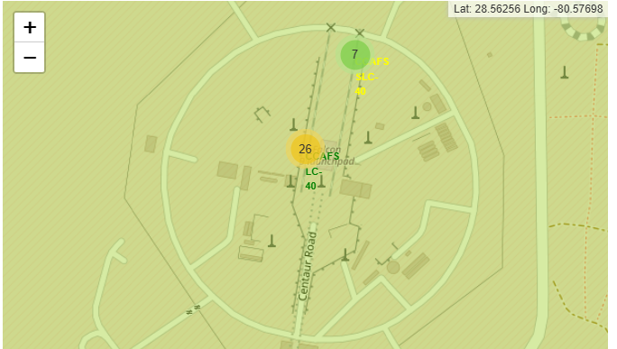
Results - CCAFS LC-40 and CCAFS LC-40

Slide 22
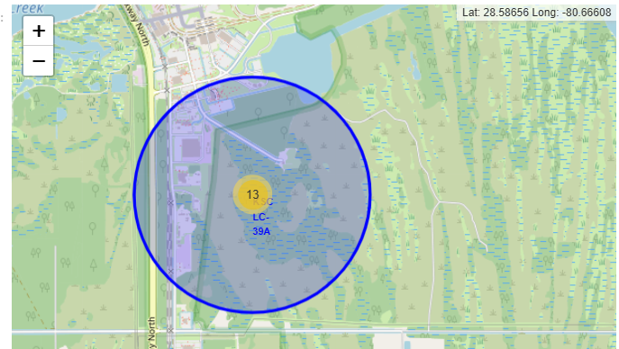
Results – KSC LC-39A - Visual Analytics

Slide 23
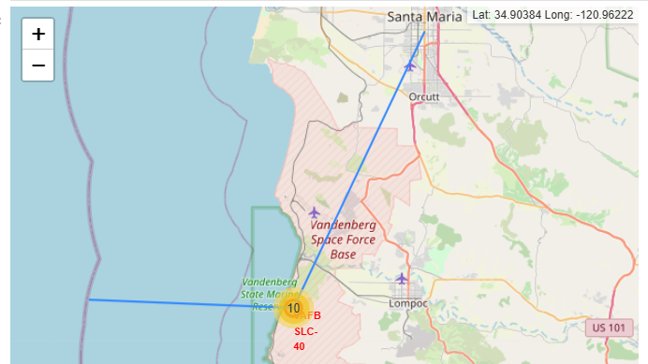
Results - VAFB SLC-40 -Visual Analytics

Slide 24
Results - Predictive Machine Learning Analysis
Predictive analysis results
Best Hyperparameter, Accuracy on test data:
Lr: {'C': 0.01, 'penalty': 'l2', 'solver': 'lbfgs'}, 0.8333333333333334
Svm: {'C': 1.0, 'gamma': 0.03162277660168379, 'kernel': 'sigmoid'}, 0.8333333333333334
Decision Tree: {'criterion': 'entropy', 'max_depth': 6, 'max_features': 'sqrt', 'min_samples_leaf': 1, 'min_samples_split': 2, 'splitter': 'best'}, 0.7222222222222222
KNN: {'algorithm': 'auto', 'n_neighbors': 10, 'p': 1}, 0.8333333333333334

Slide 25

Section 2

Slide 26
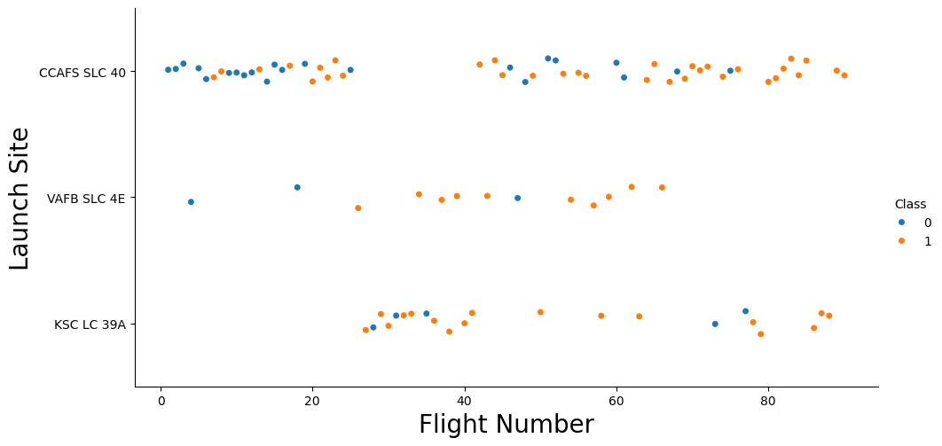
Flight Number vs. Launch Site - Scatterplot

Slide 27
Flight Number vs. Launch Site - Details
From the scatterplot of Flight Number Vs. Launch Site
With the blue dots indicating the class of Successful launches (0)
With the orange dots indicating the class of Unsuccessful launches (1)
CCAFS LC-40, has a success rate of 60 %, while KSC LC-39A and VAFB SLC 4E has a success rate of 77%.

Slide 28
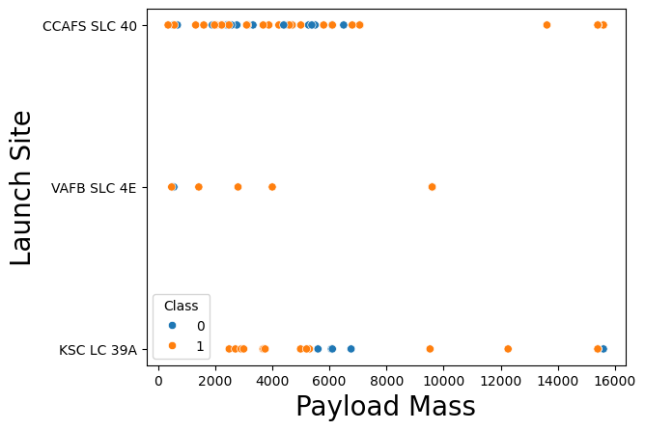
Payload vs. Launch Site
From the scatterplot of Payload Mass Vs. Launch Site :
With the blue dots indicating the class of Successful launches (0)
With the orange dots indicating the class of Unsuccessful launches (1)
The launch site VAFB SLC-40 does not use payload masses above 10000kg with mostly successful launches(80%)

Slide 29
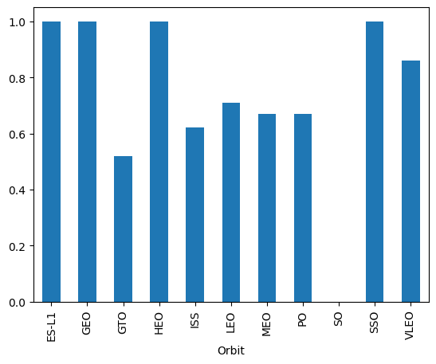
Success Rate vs. Orbit Type
From the bar plot of Success Rate Vs. Orbit Type:
The success rates (between 0 and 1) on the vertical axis
The Orbits on the horizontal axis
Orbits ES-L1, GEO, HEO and SSO are the most successful orbits (100%)
All have 1 lauch each except "SSO" with 5 launches

Slide 30
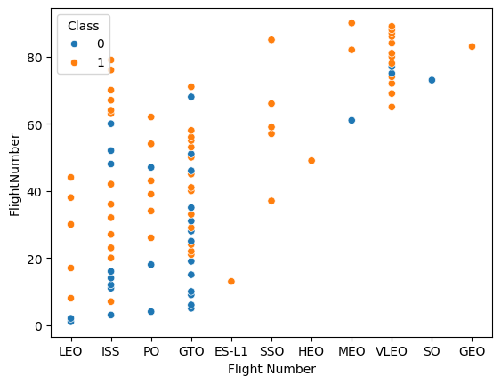
Flight Number vs. Orbit Type
From the plot of Flight number vs. Orbit type:
In the LEO orbit the Success appears related to the number of flights
On the other hand, there seems to be no relationship between flight number when in GTO orbit.

Slide 31
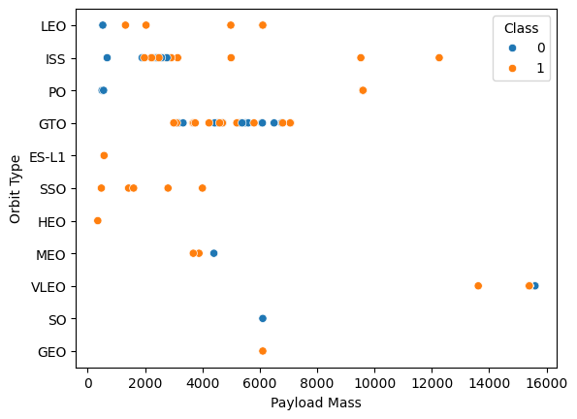
Payload vs. Orbit Type
From the scatterplot of payload vs. orbit type:
With heavy payloads the successful landing or positive landing rate are more for Polar,LEO and ISS.
However for GTO we cannot distinguish this well as both positive landing rate and negative landing(unsuccessful mission) are both there here.

Slide 32
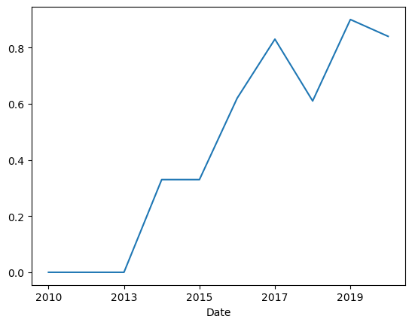
Launch Success Yearly Trend
From the line chart of yearly average success rate:
No change up until 2013
The success rates keep going up until from then increases

Slide 33
All Launch Site Names
SQL QUERY:
"%sql SELECT DISTINCT("Launch_Site") FROM SPACEXTABLE"
RESULT OF QUERY:
CCAFS LC-40
CCAFS SLC-40
KSC LC-39A
VAFB SLC-40
These are the names of the launch without any repitition

Slide 34
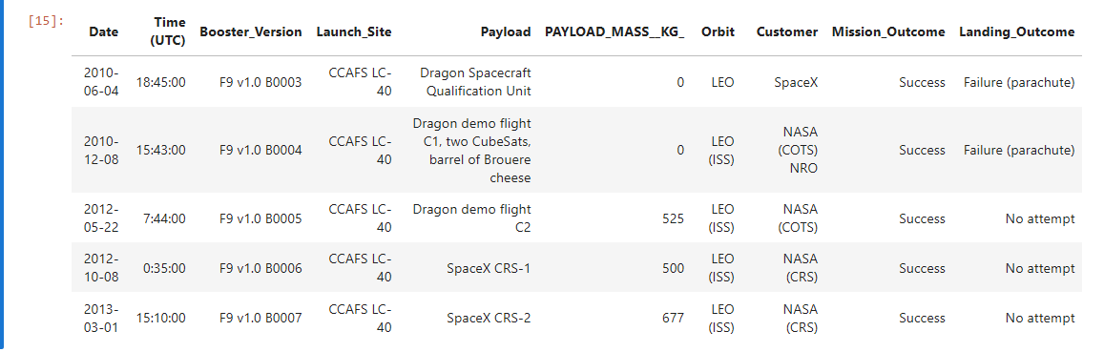
Launch Site Names Begin with 'CCA'
SQL QUERY:
"%sql SELECT * FROM SPACEXTABLE WHERE "Launch_Site" LIKE "CCA%" LIMIT 5"
RESULT OF QUERY:

Slide 35
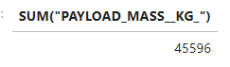
Total Payload Mass
SQL QUERY:
"%sql SELECT SUM('PAYLOAD_MASS__KG_') FROM SPACEXTABLE WHERE 'Customer' = 'NASA (CRS)' "
QUERY RESULT:

Slide 36
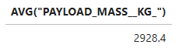
Average Payload Mass by F9 v1.1
SQL QUERY:
%sql SELECT AVG("PAYLOAD_MASS__KG_") FROM SPACEXTABLE WHERE "Booster_Version" = "F9 v1.1"
QUERY RESULT:

Slide 37
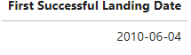
First Successful Ground Landing Date
SQL QUERY:
' %sql SELECT min("Date") as "First Successful Landing Date" FROM SPACEXTABLE '
QUERY RESULT:

Slide 38
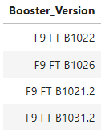
Successful Drone Ship Landing with Payload between 4000 and 6000
SQL QUERY:
' %sql SELECT ("Booster_Version") FROM SPACEXTABLE WHERE "Landing_Outcome" = "Success (drone ship)" AND "PAYLOAD_MASS__KG_" BETWEEN 4000 AND 6000 '
QUERY RESULT:

Slide 39
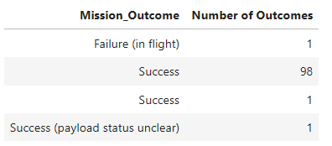
Total Number of Successful and Failure Mission Outcomes
SQL QUERY:
' %sql SELECT "Mission_Outcome", COUNT("Mission_Outcome") as "Number of Outcomes" FROM SPACEXTABLE GROUP BY ("Mission_Outcome") '
QUERY RESULT:

Slide 40
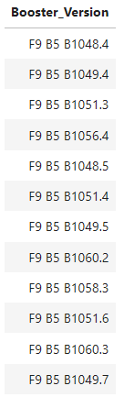
Boosters Carried Maximum Payload
SQL QUERY:
' %sql SELECT "Booster_Version" FROM SPACEXTABLE WHERE "PAYLOAD_MASS__KG_" = (SELECT max("PAYLOAD_MASS__KG_") FROM SPACEXTABLE ) '
QUERY RESULT:

Slide 41
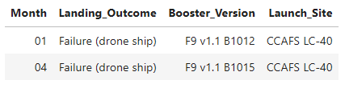
2015 Launch Records
SQL QUERY:
' %sql SELECT substr(Date, 6, 2) as "Month", "Landing_Outcome", "Booster_Version", "Launch_Site" FROM SPACEXTABLE WHERE "Landing_Outcome" = "Failure (drone ship)" AND substr(Date, 0, 5) = "2015" '
QUERY RESULT:

Slide 42
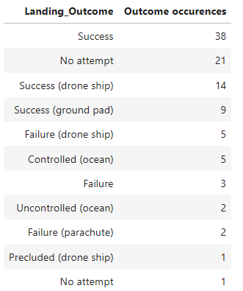
Rank Landing Outcomes Between 2010-06-04 and 2017-03-20
SQL QUERY:
' %sql SELECT "Landing_Outcome", COUNT("Landing_Outcome") as "Outcome occurences" FROM SPACEXTABLE GROUP BY "Landing_Outcome" ORDER BY "Outcome occurences" DESC '
QUERY RESULT:

Slide 43

Section 3

Slide 44
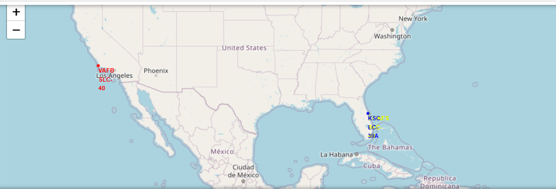
Map Of Launch sites with markers

Slide 45
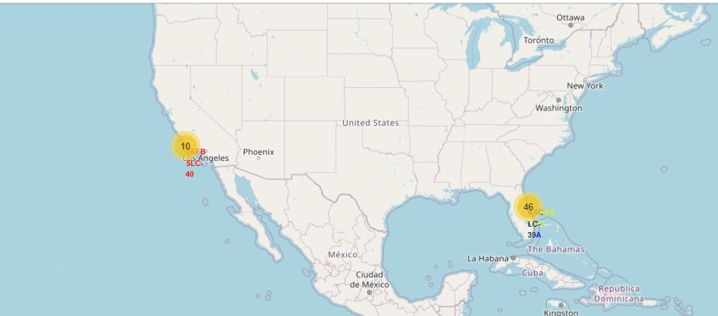
Map of Launch Site with Labeled Launch Outcomes

Slide 46
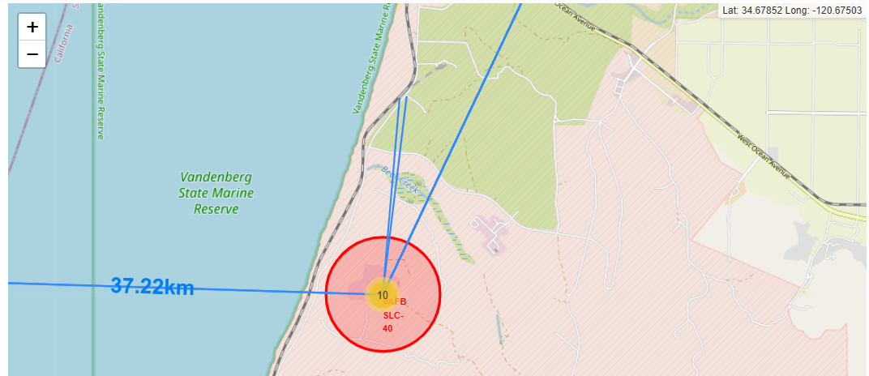
Proximity of Launch site to nearby locations

Slide 47

Section 4

Slide 48
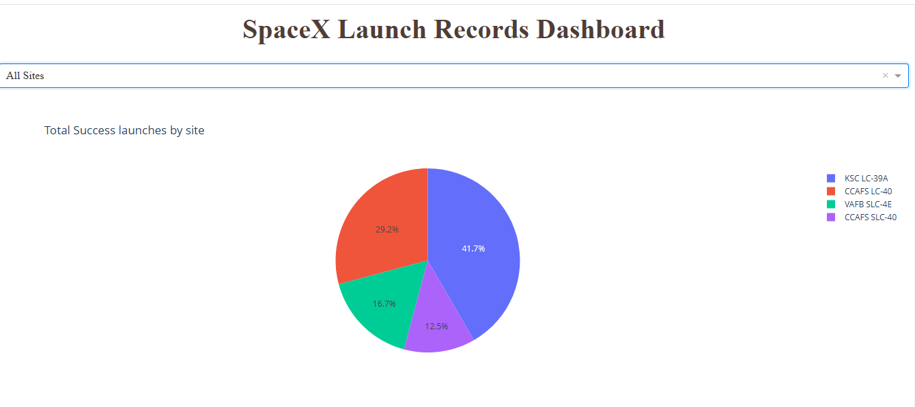
Launch Success For All Sites - Pie Chart

Slide 49
Launch Success For All Sites - Pie Chart
The launch site KSC LC-39A has the most successful number of launches (41.7%)
The launch site with the least number of launches is CCAFS SLC-40 (12.5% )

Slide 50
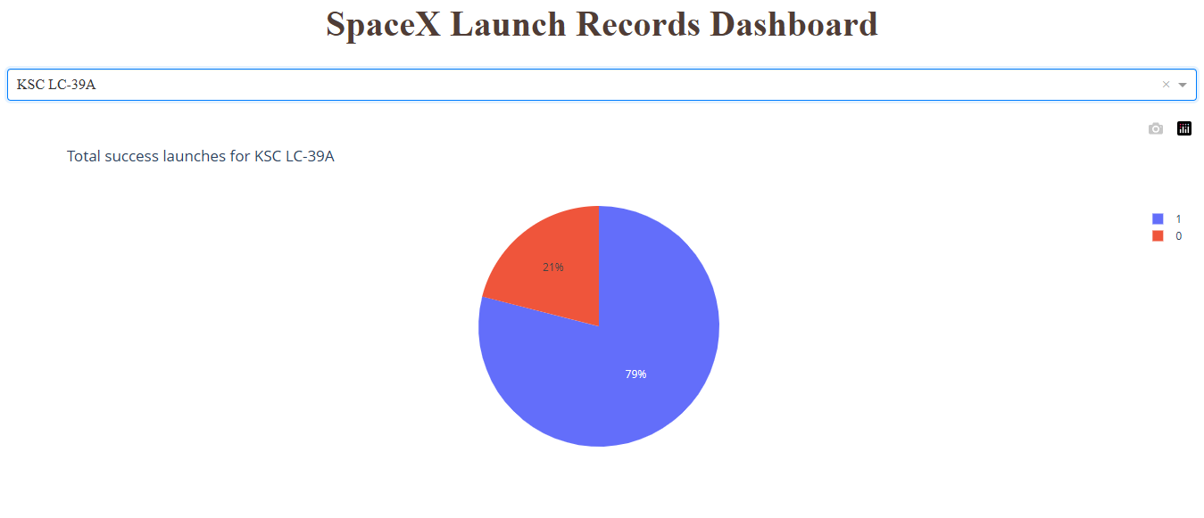
Launch Site with the highest launch success rate
KSC LC-39A (41.7%)

Slide 51
Launch Site with the highest launch success rate
KSC LC-39A (41.7%)
The success rate is 79%
The failure rate is 21%, more than 3 times less than its success rate

Slide 52
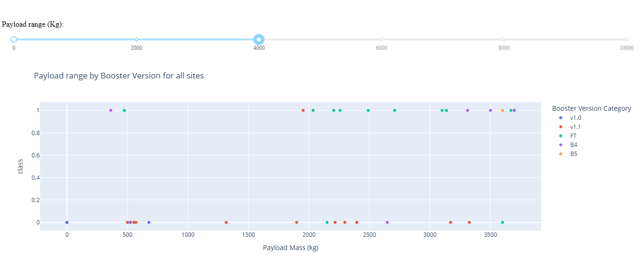
Payload vs. Launch Outcome Scatter Plot of All Sites

Slide 53
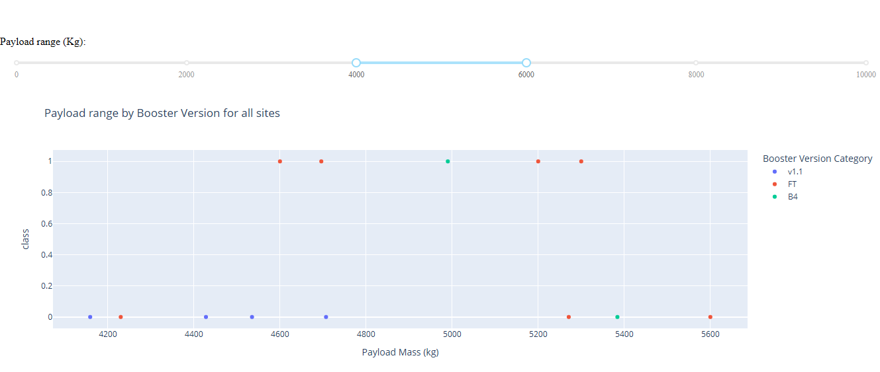
Payload vs. Launch Outcome Scatter Plot of All Sites

Slide 54
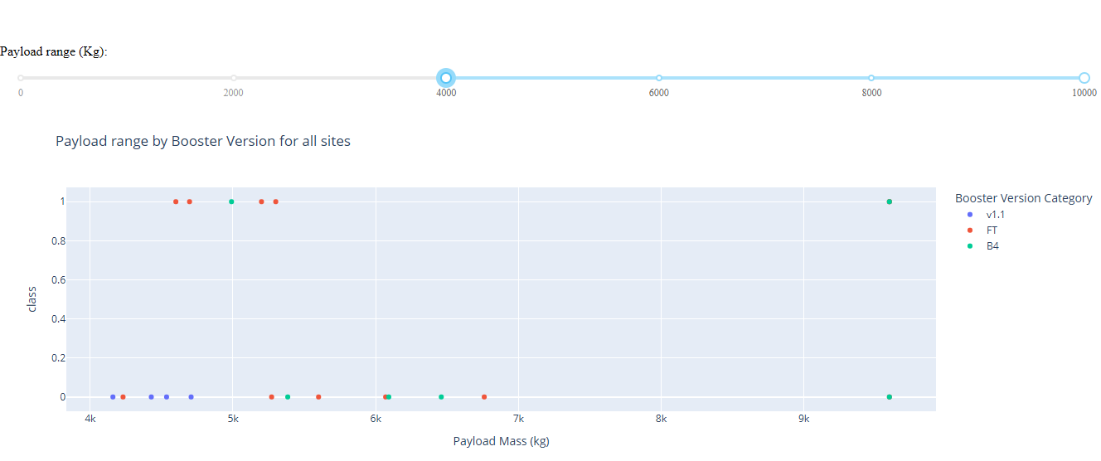
Payload vs. Launch Outcome Scatter Plot of All Sites

Slide 55
Results of Visuals Analysis
The Payload Range with the highest success rate is 3000kg to 4000kg

Slide 56

Section 5

Slide 57
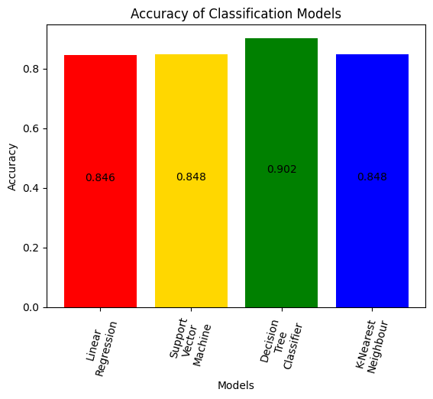
Classification Accuracy
The Decision Tree Classifier model has the highest classification accuracy

Slide 58

Confusion Matrix
The false positives are the main issue here
This is because the predictions say it landed but it actually did not
The false negative is zero, so we have no problems there

Slide 59
Conclusions
The success rate of launches increases from 2013 onwards
The most successful launch orbit is "SSO"
"KSC LC-39A" is the launch site has the highest success rate
It also has the most successful launches
The payload range with the highest accuracy is 3000kg to 4000kg

Slide 60


